Slide 1
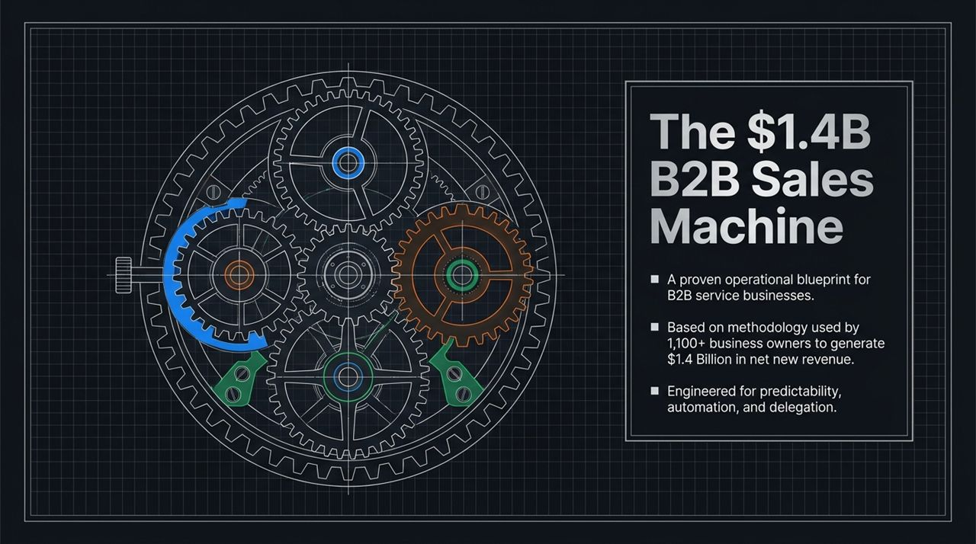
Notes:
Welcome, everyone. Today, I’m going to walk you through an operational blueprint for B2B service businesses that we call 'The $1.4B Sales Machine'.
This methodology isn't theoretical. Over the past 12 years, we’ve used this exact framework across more than 1,100 business owners to generate over $1.4 Billion in net new revenue.
If you look at the diagram on the left, notice how the gears interlock—that is intentional. The core objective of today’s session is to take revenue creation out of the realm of luck or manual grind, and engineer it for three things: predictability, automation, and delegation.
By the time we finish, you'll see how to systematically build a machine that produces sales reliably, regardless of how busy you get delivering client work. Let's dive in.
https://www.youtube.com/watch?v=_6oWVTKGtJw

Slide 2
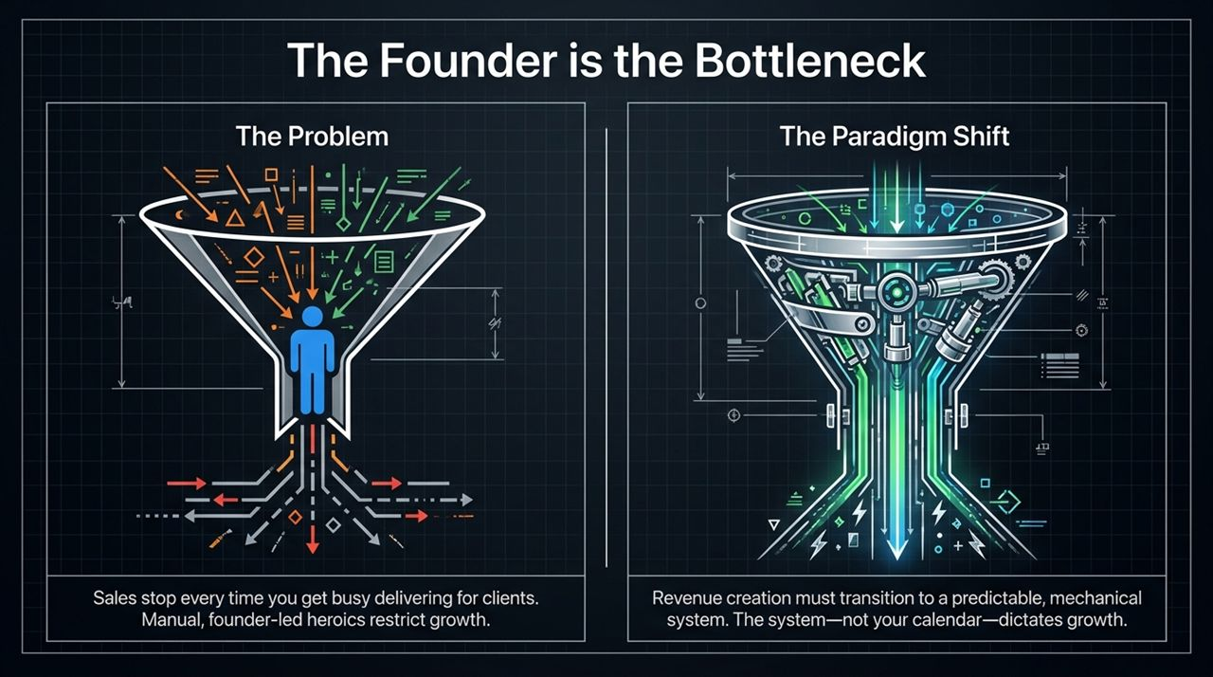
Notes:
Let's talk about the single biggest growth barrier in B2B service businesses: The Founder Bottleneck.
On the left, look at 'The Problem' funnel. Right now, most founders run their business on manual heroics. When you need clients, you hustle, make calls, network, and close deals.
But what happens next? You close those deals, you get busy delivering the work, and sales completely halt. The pipeline dries up. You hit an endless roller-coaster revenue cycle.
Now look at the right: 'The Paradigm Shift'. We need to convert revenue creation into a mechanical, predictable system.
Growth cannot depend on your personal calendar or daily energy levels. The system—not you—must dictate revenue. When you transition to a machine, delivery busywork no longer halts client acquisition.

Slide 3
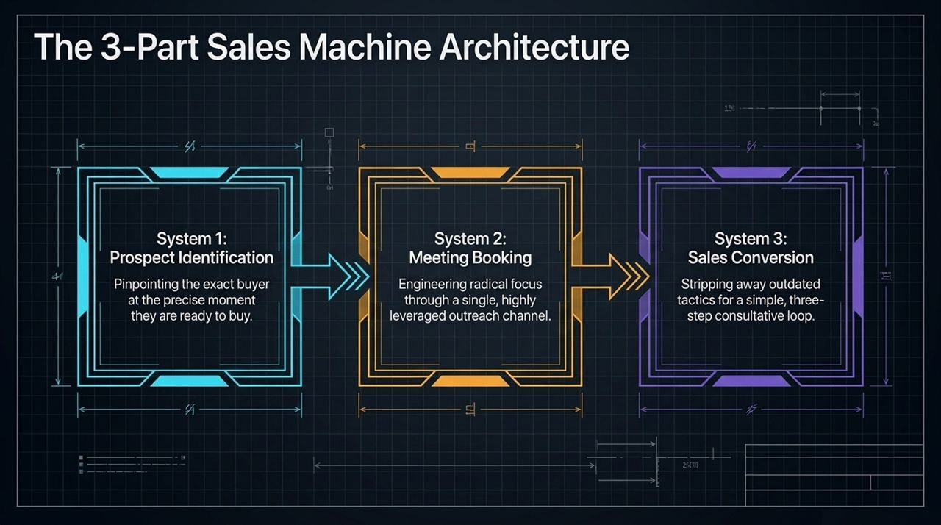
Notes:
To break free from founder dependency, we structure our sales machine into three distinct, interconnected subsystems:
System 1: Prospect Identification — Pinpointing the exact buyers who are ready to buy right now, avoiding wasted effort on unmotivated leads.
System 2: Meeting Booking — Engineering radical focus through a single, highly leveraged outreach channel to fill your calendar.
System 3: Sales Conversion — Replacing outdated 12-step closing tactics with a sleek, 3-step consultative loop.
When these three systems function together, prospect data flows seamlessly into booked meetings, which then convert into signed clients on repeat.

Slide 4
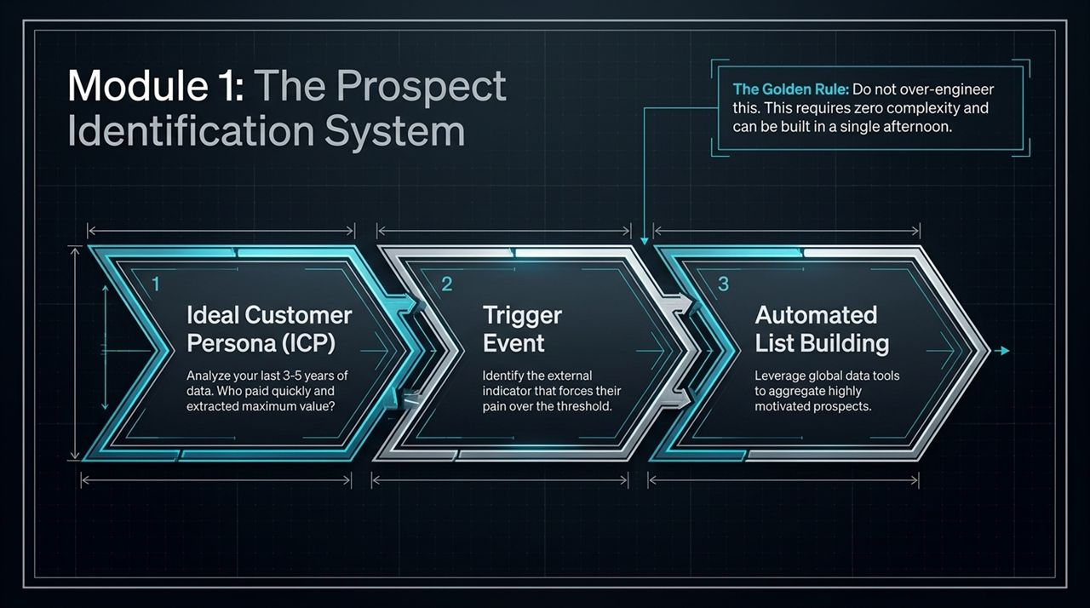
Notes:
Let's break down System 1: Prospect Identification.
Before we begin, remember the Golden Rule at the top right: Do not over-engineer this. You don't need complex tools or dedicated research teams sitting with spreadsheets. This can be built in a single afternoon.
The system relies on three steps:
Ideal Customer Persona (ICP): Review your past 3 to 5 years of client data. Identify who closed fast, paid easily, got maximum value, and gave you high lifetime value.
Trigger Event: Identify the exact external indicator that forces their operational pain past their action threshold.
Automated List Building: Use modern data aggregation tools to pull these targeted prospects automatically.*

Slide 5
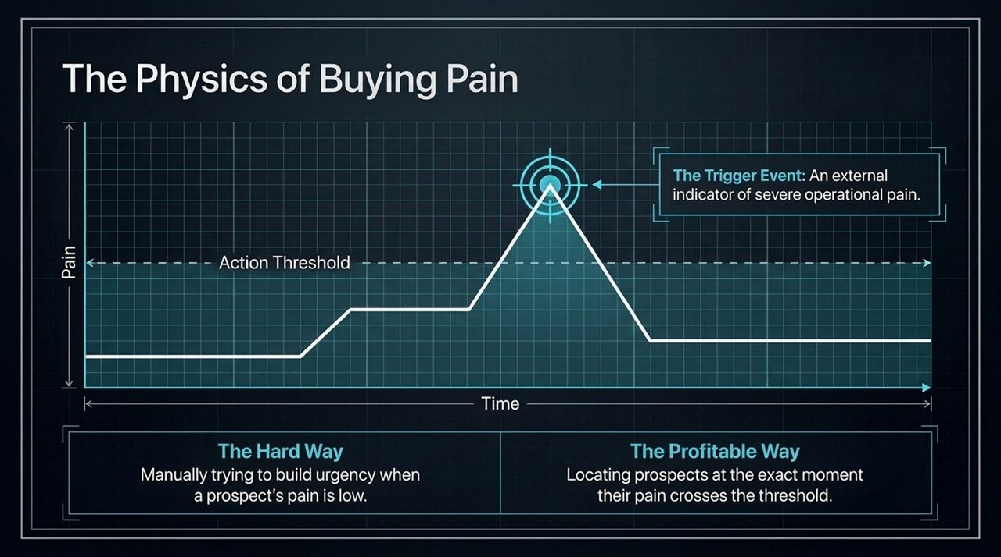
Notes:
Understanding prospect psychology comes down to the 'Physics of Buying Pain'.
Look at the graph: Pain runs along the vertical axis, Time along the horizontal axis.
Most sales teams attempt 'The Hard Way': reaching out to prospects when their pain is low and trying to artificially build urgency. It’s exhausting and inefficient.
The 'Profitable Way' relies on identifying the Trigger Event. This is an external indicator—like hiring or firing a sales team, raising a funding round, or facing new compliance rules—that spikes their internal pain above their 'Action Threshold'.
When you contact prospects at peak pain, sales calls shift from convincing them to helping them solve a real, active problem.

Slide 6
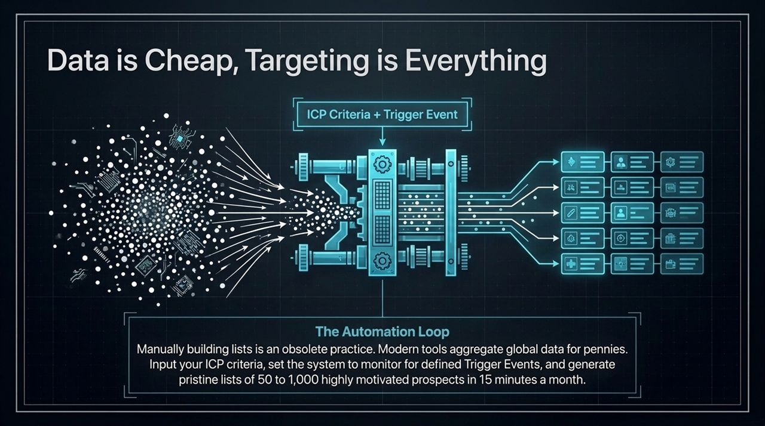
Notes:
Manually scraping contacts and building lists is obsolete.
Today, contact data is a commodity. Tools like Apollo and Clay allow you to access thousands of contact details instantly.
The real power lies in the Automation Loop shown here:
You input your ICP parameters alongside specific Trigger Event monitors.
The system processes the market data and outputs pristine lists of 50 to 1,000 highly motivated prospects in just 15 minutes a month.
Once set up, high-intent lead data flows into your pipeline automatically.

Slide 7
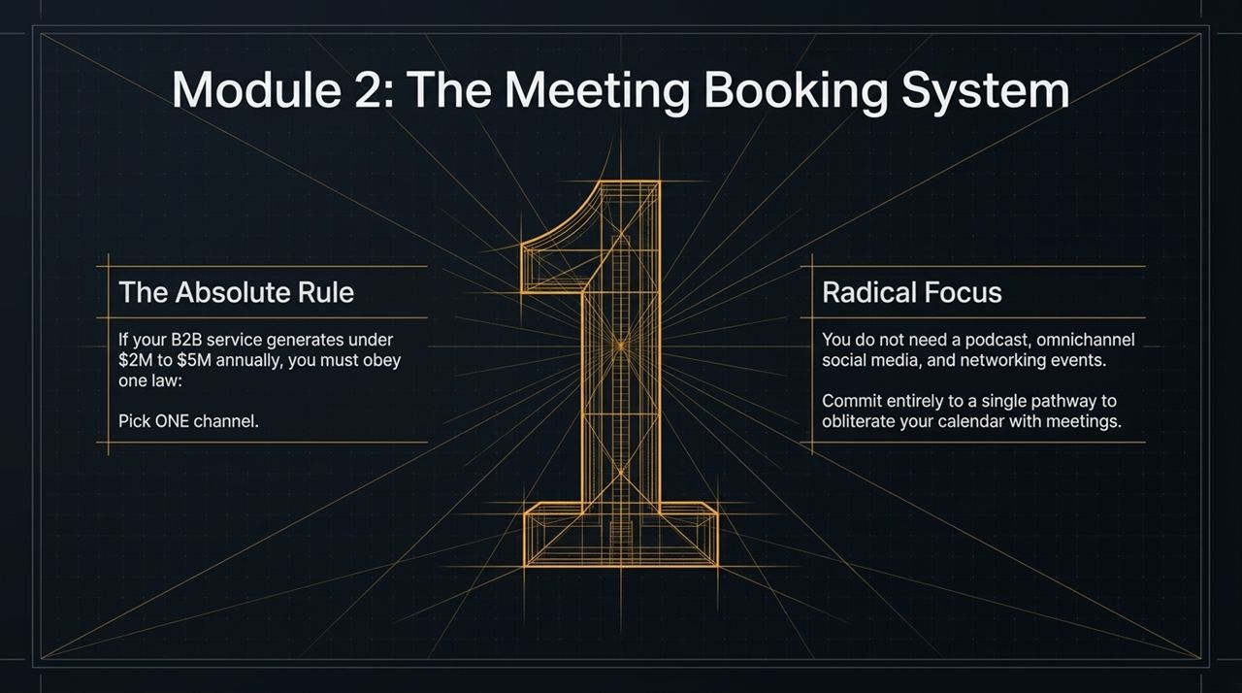
Notes:
Once you know who to target, you need System 2: The Meeting Booking System.
If your B2B service generates under $2M to $5M annually, obey The Absolute Rule: Pick ONE channel.
Avoid the trap of trying to run a podcast, post across four social channels, manage PPC ads, and attend networking events all at once.
Focus all energy on mastering a single channel. Sticking to one pathway builds momentum and consistently fills your calendar.

Slide 8
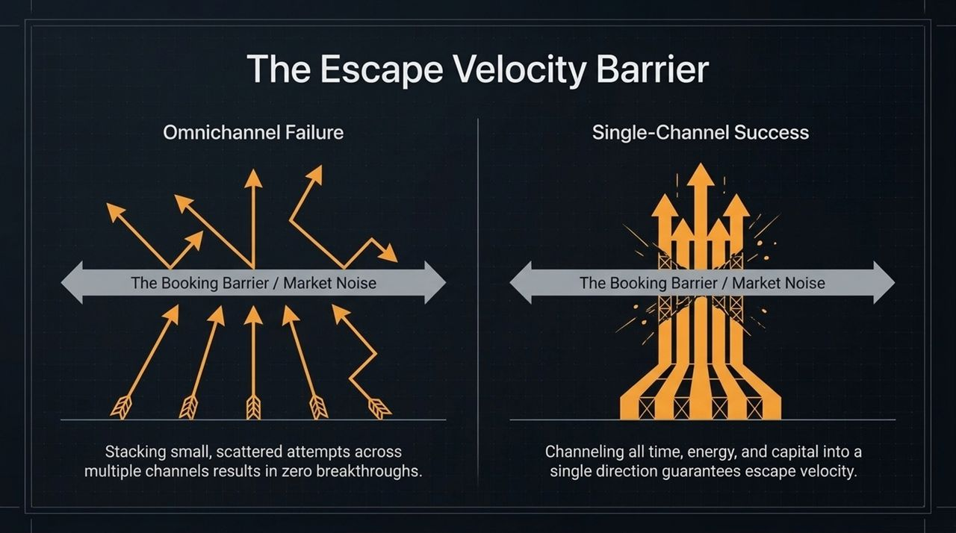
Notes:
Why is single-channel focus so crucial? Consider 'The Escape Velocity Barrier'.
On the left, 'Omnichannel Failure' shows scattered efforts across multiple channels. Splitting energy across cold outreach, content, ads, and events leaves you trapped under the market noise barrier.
On the right, 'Single-Channel Success' shows focused execution. Channeling 100% of your energy into one method breaks through the booking barrier—achieving escape velocity.
Commit to one channel until it consistently produces meeting volumes before scaling elsewhere.

Slide 9
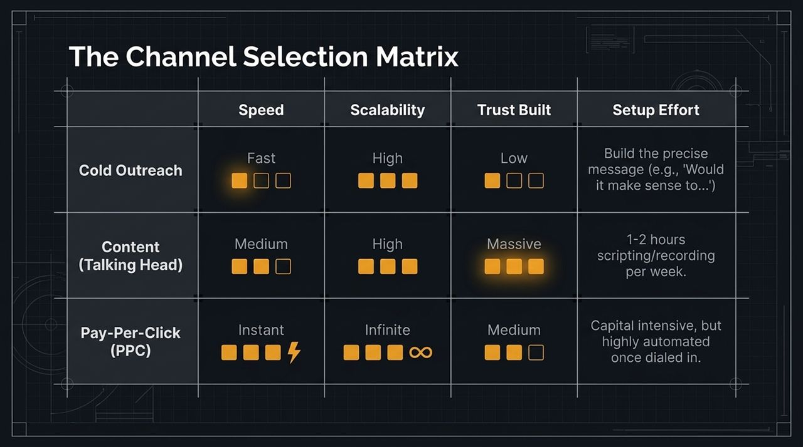
Notes:
How do you choose your single channel? Use this matrix comparing Cold Outreach, Content, and Pay-Per-Click (PPC):
Cold Outreach (Email/LinkedIn): Fast speed, high scalability, low setup effort. Requires a crisp, low-friction offer phrase like: 'Would it make sense to...'.
Content (Talking-Head Videos): Medium speed, high scalability, builds deep trust. Requires just 1–2 hours per week to script and record simple, value-rich videos.
Pay-Per-Click (PPC): Instant speed, infinite scale. Requires capital up-front, but operates on auto-pilot once dialed in.
Select the channel that best matches your immediate capital, time, and strengths, and commit to it fully.

Slide 10
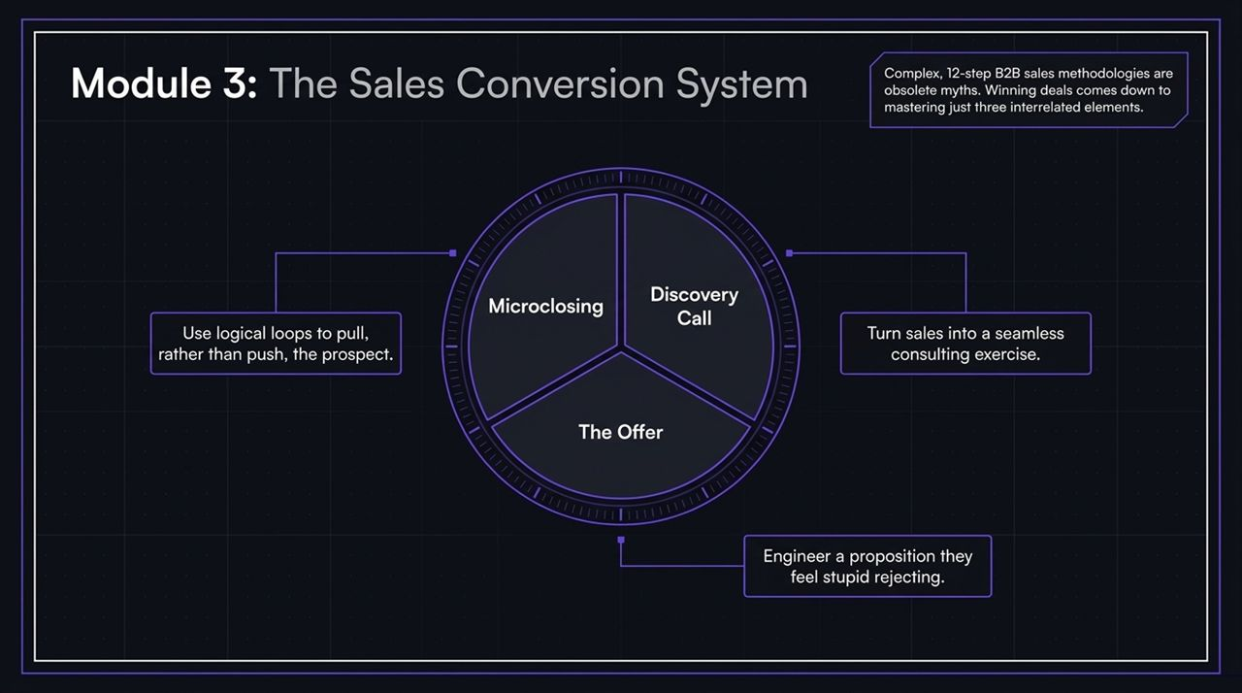
Notes:
Now that meetings are booked, let's explore System 3: Sales Conversion.
Complex 12-step sales playbooks are unnecessary for B2B services. Closing deals effectively comes down to mastering three elements:
Discovery Call: Structuring the conversation as a consulting exercise rather than a aggressive pitch.
The Offer: Designing a clear proposition that minimizes friction.
Microclosing: Using logical questions to guide prospects forward naturally.*

Slide 11
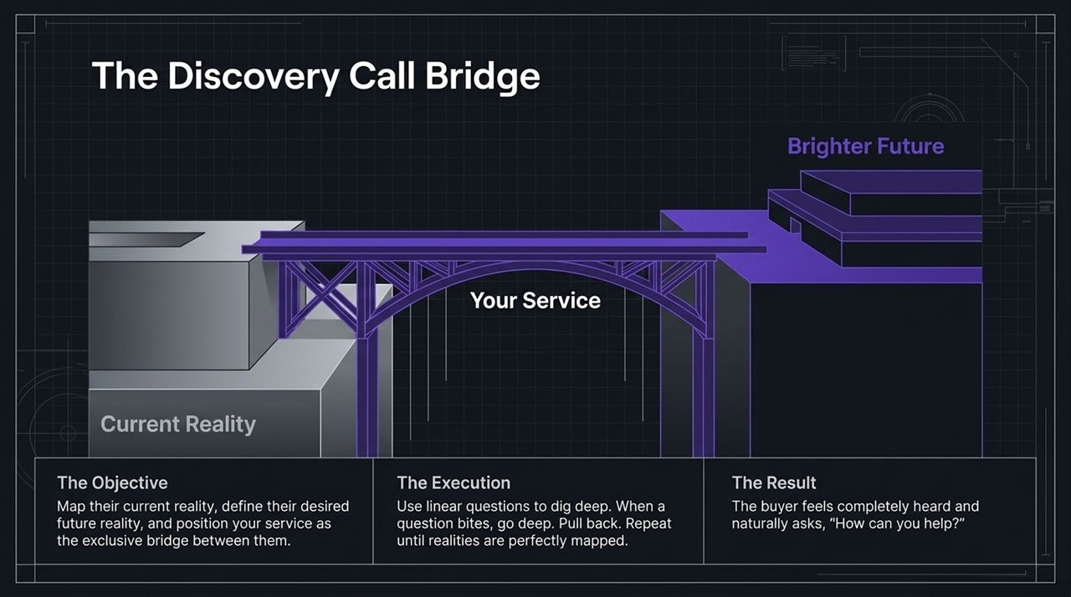
Notes:
The discovery call operates on a simple visual concept: The Bridge.
Your goal is not to pitch immediately, but to map two environments:
Current Reality: Where are they struggling right now?
Brighter Future: What exact business outcomes do they want to achieve?
Execution: Ask linear diagnostic questions. When a question uncovers pain, dig deeper before stepping back.
Result: Once both sides are mapped, position your service as the exclusive bridge connecting them. The prospect will naturally ask: 'How can you help us build this?'

Slide 12
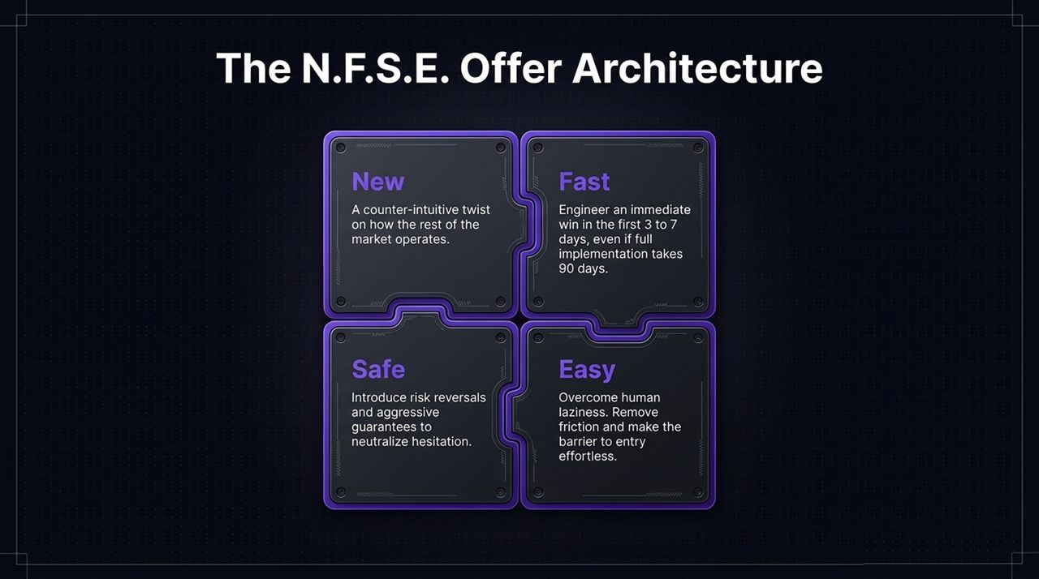
Notes:
To make your offer compelling, construct it using the N.F.S.E. Framework:
N – New: Present a counter-intuitive twist or fresh perspective compared to traditional market approaches.
F – Fast: Deliver an initial win within the first 3 to 7 days, even if full engagement takes 90 days.
S – Safe: Remove perceived risk through performance guarantees, trials, or risk-reversal terms.
E – Easy: Eliminate operational friction so onboard steps feel effortless for busy clients.
Structuring your proposition this way minimizes hesitation and speeds up decision-making.

Slide 13
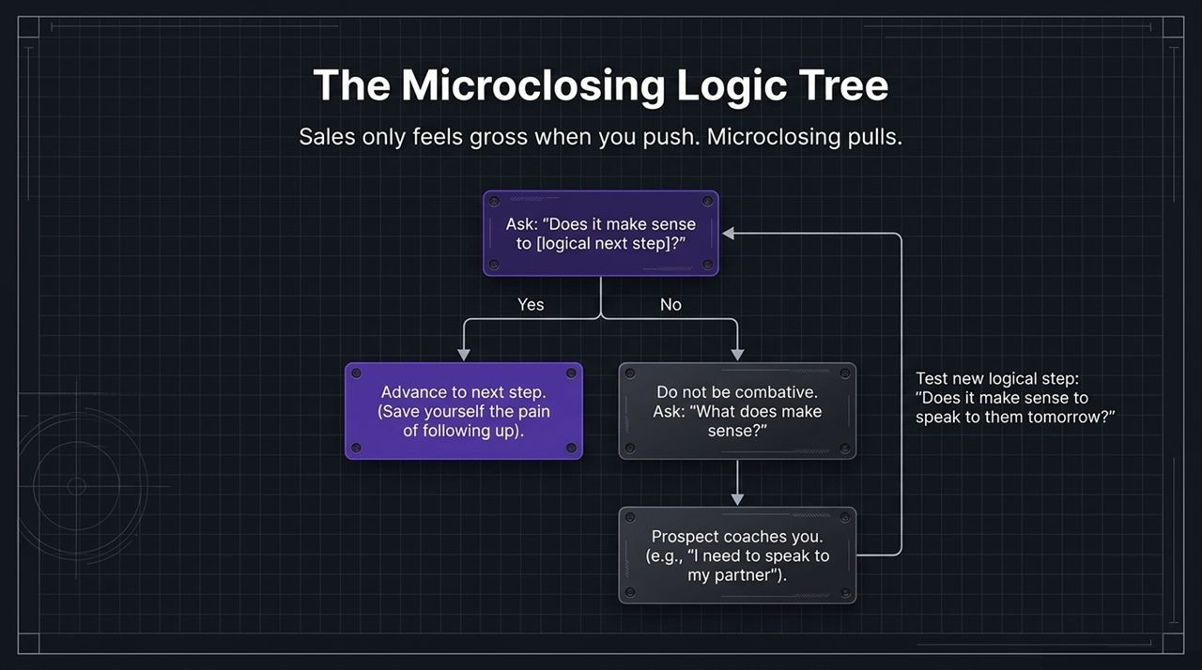
Notes:
High-pressure closing tactics often backfire. Microclosing uses small, logical steps to maintain momentum throughout the sales process.
At every stage, ask a simple question: 'Does it make sense to [logical next step]?'
If Yes: Advance seamlessly to the next stage.
If No: Avoid arguing. Instead, ask: 'What does make sense?'
This prompts the prospect to explain their internal process (e.g., 'I need to review this with my partner first'). You can then set the next logical micro-step: 'Does it make sense to connect tomorrow after you've spoken?'

Slide 14
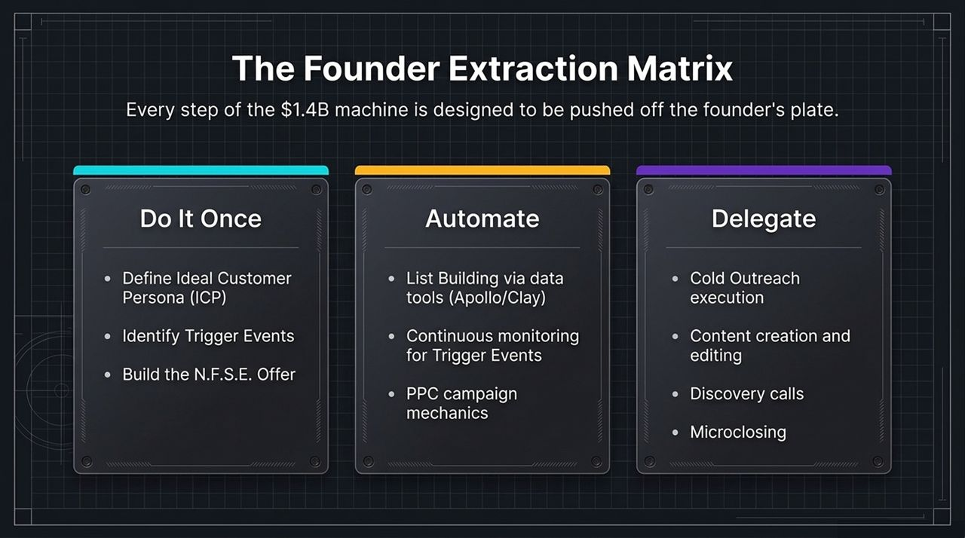
Notes:
To build a business that runs independently, map every sales function into three categories using the Founder Extraction Matrix:
Do It Once: Set strategy up-front—define the ICP, set trigger event conditions, and build the N.F.S.E. offer.
Automate: Use software for list creation, trigger monitoring, and ad delivery.
Delegate: Hand off routine execution—such as cold outreach cadences, media editing, discovery calls, and microclosing—to specialized team members or account executives.
Categorizing tasks this way helps systematically remove the founder from daily sales tasks.

Slide 15
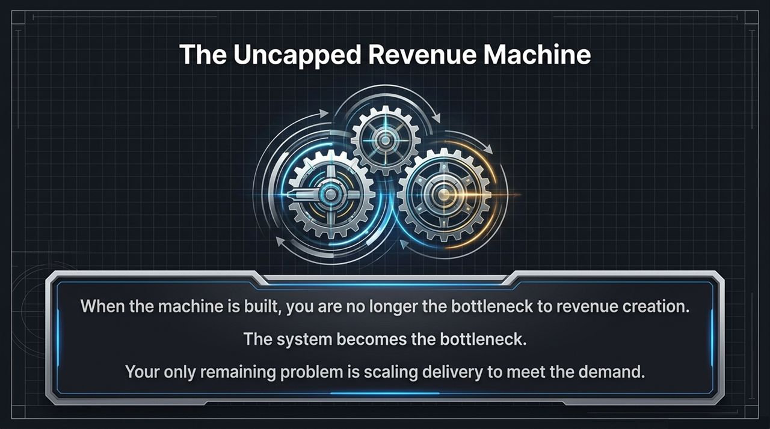
Notes:
Once all three modules are deployed, your sales process transitions from manual effort to an automated operational model.
You are no longer the bottleneck limiting revenue growth.
Instead, throughput is determined by system capacity—how many targeted prospects flow into the pipeline.
Your main focus shifts from chasing sales to expanding service capacity to meet incoming client demand.

Slide 16
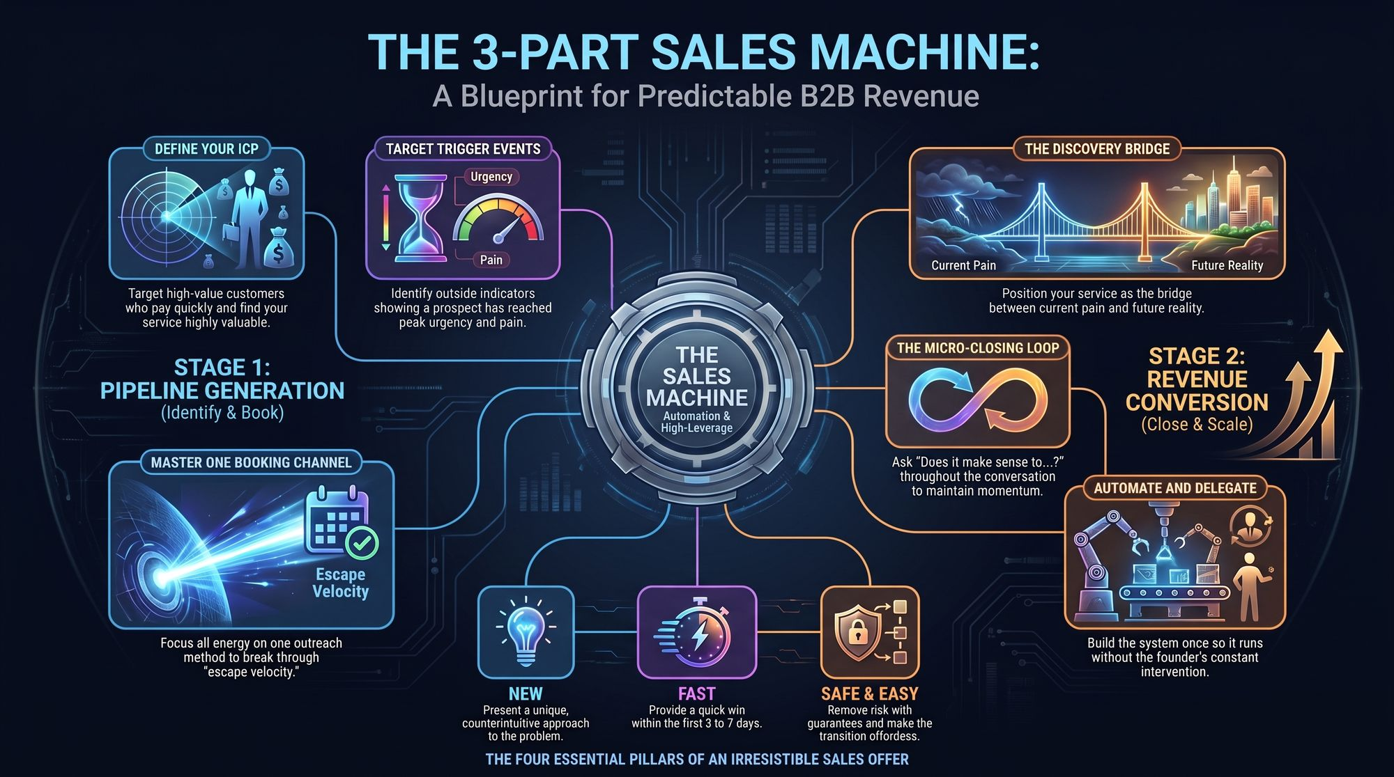
Notes:
To conclude, let's review the complete end-to-end blueprint:
Stage 1: Pipeline Generation (Identify & Book)
Define your ICP around fast-paying, high-value accounts.
Track specific Trigger Events that indicate high urgency.
Focus on one primary outreach channel to break through market noise.
Stage 2: Revenue Conversion (Close & Scale)
Conduct discovery calls using the Discovery Bridge framework.
Package your solution into a clear N.F.S.E. offer.
Guide deals forward using incremental microclosing steps.
Systematically automate and delegate execution tasks.
Implement these components step-by-step to build a reliable, scalable sales engine for your business. Thank you!
https://www.youtube.com/watch?v=_6oWVTKGtJw

